Slide 1

Artificial Intelligence
Lecture 3 (part1)
By/ aly maher abdelfattah

Slide 2
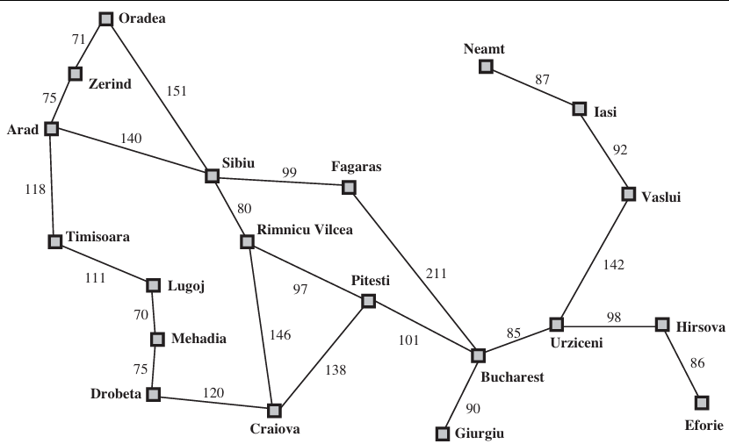
Solving Problems by Searching
How an agent can look ahead to find a sequence of actions that will achieve its goal.
Problem-solving agent is the agent needs to plan ahead: to consider a sequence of actions that form a path to a goal state.
The computational process agent undertakes is called search.
Two types of algorithms:
1. Informed
2. Uninformed

Slide 3
Four-phase problem-solving process
Agent Type | Description
Goal Formulation | The agent adopts the goal of reaching Bucharest.
Problem Formulation | The agent devises a description of the states and actions necessary to reach the goal. For our agent, one good model is to consider the actions of traveling from one city to an adjacent city, and therefore the only fact about the state of the world that will change due to an action is the current city.
Search | Before taking any action in the real world, the agent simulates sequences of actions in its model, searching until it finds a sequence of actions that reaches the goal. Such a sequence is called a solution. The agent might have to simulate multiple sequences that do not reach the goal, but it will find a solution, or it will find that no solution is possible.
Execution | The agent can now execute the actions in the solution, one at a time.

Slide 4
Search Space Definitions
Term | Definition
Initial State | The state from which the agent infers that it is at the beginning
Goal state
Operators (actions) | A description of what possible action does (that change the state of the world) and their outcome
State space | All states reachable from initial by any sequences of actions. A path: is any sequence of actions that lead from one state to another
Goal Test | A function that checks whether a given state meets the problem's goal criteria.
Path Cost | When it matters how to get there (goal state)

Slide 5
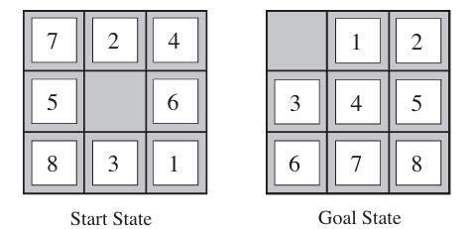

8-puzzle problem
Term | Definition
Initial State | The location of each of the 8 tiles in one of the nine squares
Goal state | squares are numbered from one to eight around the square
Operators (actions) | Blank moves: 1) Left 2) Right 3) Up 4) Down
State space | All states reachable from initial by any sequences of actions. A path: is any sequence of actions that lead from one state to another
Goal Test | State match the goal configurations
Path Cost | Each step cost 1, total path cost = no. of steps

Slide 6
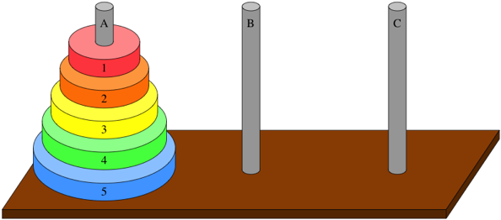

Towers of Hanoi problem
Term | Definition
Initial State | The configuration of disks on the poles at the start.
Goal state | Disks arranged from largest (at bottom) to smallest on the goal pole.
Operators (actions) | Move disk x from pole y to pole z, subject to constraints: • Cannot move a disk on top of a smaller disk • Cannot move a disk if other disks are on top
State space | All reachable configurations of disks and poles from the initial state by any sequence of actions.
Goal Test | Checks if all disks are arranged from largest to smallest on the goal pole.
Path Cost | Each step cost 1, total path cost = no. of steps

Slide 7
Searching for Solutions
Traversal of the search space
– From the initial state to a goal state.
– Legal sequence of actions as defined by successor function.
A search tree is generated
– Nodes are added as more states are visited

Slide 8
Search Algorithms
A search algorithm takes a search problem as input and returns a solution.
Each node in the search tree corresponds to a state in the state space and the edges in the search tree correspond to actions.
The root of the tree corresponds to the initial state of the problem.
The state space describes the set of states in the world, and the actions that allow transitions from one state to another.
The search tree describes paths between these states, reaching towards the goal.
The search tree may have multiple paths to any given state, but each node in the tree has a unique path back to the root (as in all trees).

Slide 9
Searching Strategies
Uninformed Search | Informed Search
– Breadth-first – Uniform-cost search – Depth-first – Depth-limited search – Iterative deepening – Bi-directional search | – Best-first search – Search with heuristics – Memory-bounded search – Iterative improvement search
Uninformed Search (blind search)
• Number of steps, path cost unknown.
• Agent knows when it reaches a goal.
Informed Search (heuristic search)
• Agent has background information about the problem

Slide 10

Thank you

